Slide 1



異なる親和性でのPt/n-アルカン界面の 界面熱抵抗と表面液体構造の相関
0
日本機械学会熱工学コンファレンス2022
A122
Surface Liquid Structure Correlation with Interface Thermal Resistance of Pt/n-alkane Interface at Different Affinities
○ Qing-Yao Luo¹, Donatas Surblys², Hiroki Matsubara², Taku Ohara²
1 東北大学大学院工学研究科
2 東北大学流体科学研究所
Oct. 8th, 2022
Notes:
Good afternoon everybody. I am Qingyao Luo. Today I’m glad to be here to share my research about surface liquid structure correlation with interface thermal resistance of Pt/n-alkane interface at different affinities.

Slide 2

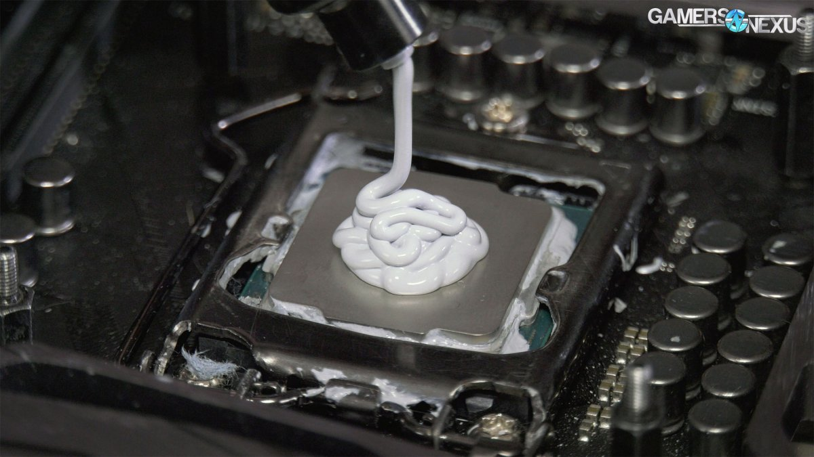
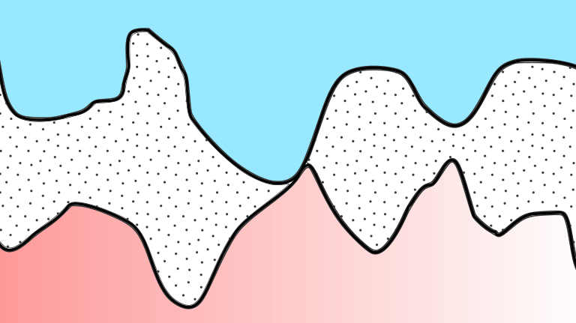
Background
Air
ITR is very high
interface thermal resistance
© gamersnexus
https://www.gamersnexus.net
Thermal interface material (TIM) fills the air–gap
ITR is decreased
TIM
Billions transistors in one chip
size of semiconductors
density of heat dissipation
significance of ITR
Understanding thermal transport mechanism at the interface of
solid-TIM at nano scale is essential
Notes:
The surface of packed chip was uneven. If we connect chip and heat sink directly, there would be a air gap. Then resistance to transfer thermal energy is very high. The common method is inserting the thermal interface material. The air gap is filled then ITR is decreased. With the development of technology, billions transistors can be integrated into one chip. This causes size of semiconductors is shrunken, density of heat dissipation increased. Then ITR cannot be ignored. It is essential to understand thermal transport mechanism at the interface of solid-TIM from the nano view.

Slide 3
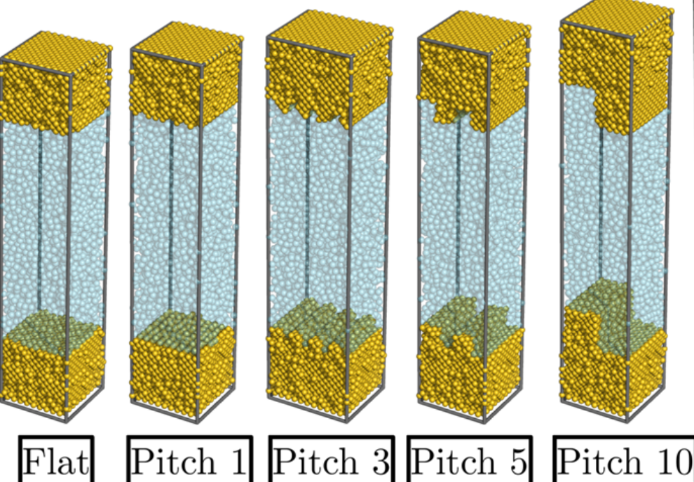
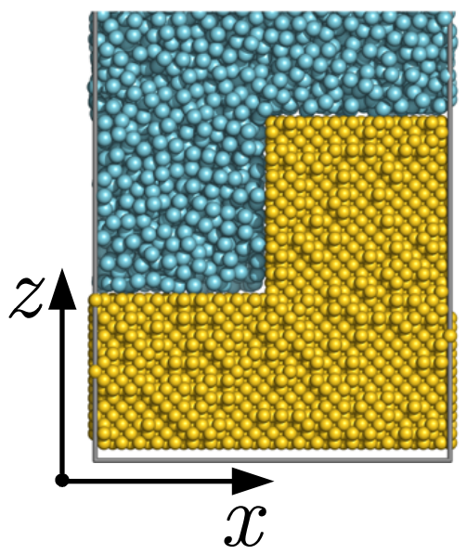
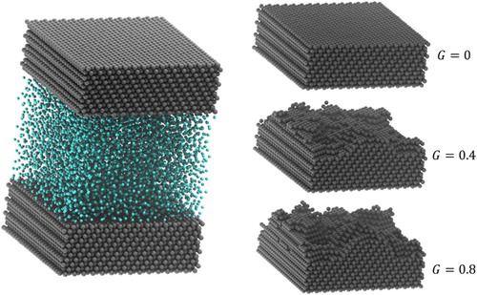
Existing Research on ITR of SLS System
work of our group
Au-Ar-Au system
Surblys D, et al. J. Chem. Phys. 150, 114705 (2019)
at low affinity: ITR_{large groove} > ITR_{small groove}
at high affinity: ITR_{rough surface} < ITR_{flat surface}
at super high affinity: highly ordered liquids increase ITR
Polyatomic SLS system should be paid more attention. Roughness is an essential parameter on ITR.
work of others
Ag-Ar-Ag system
Same fractal dimension and depth of roughness have same ITR and liquid density profiles.
Increase roughness won’t be helpful to decrease ITR at high η.
Frank M, et al. J. Chem. Phys. 151, 134705 (2019)
Notes:
In the previous work of our group, we researched the Au-Ar-Au systems, and find that at low affinity, ITR of large pitch is larger than small pitch; and at high affinity, ITR of rough surface is smaller than flat surface. at super high affinity, highly ordered liquids would increase ITR. one group researched the influence of random roughness effect on ITR. it has been proved that roughness is an essential parameter on ITR. Also polyatomic sls system is much more complex

Slide 4
Existing Research on ITR of SLS System
work of our group
Au-Ar-Au system
Objective:
Investigating surface liquid structure correlation with interface thermal resistance of Pt/n-alkane (TIM) interfaces at different affinities
Surblys D, et al. J. Chem. Phys. 150, 114705 (2019)
at low affinity: ITR_{large groove} > ITR_{small groove}
at high affinity: ITR_{rough surface} < ITR_{flat surface}
at super high affinity: highly ordered liquids increase ITR
Polyatomic SLS system should be paid more attention. Roughness is an essential parameter on ITR.
work of others
Ag-Ar-Ag system
Same fractal dimension and depth of roughness have same ITR and liquid density profiles.
Increase roughness won’t be helpful to decrease ITR at high η.
Frank M, et al. J. Chem. Phys. 151, 134705 (2019)
Notes:
To continue the previous work and to be closer to engineering application, we aim to investigate surface liquid structure correlation with interface thermal resistance of Pt/n-alkane (TIM interfaces at different affinities

Slide 5
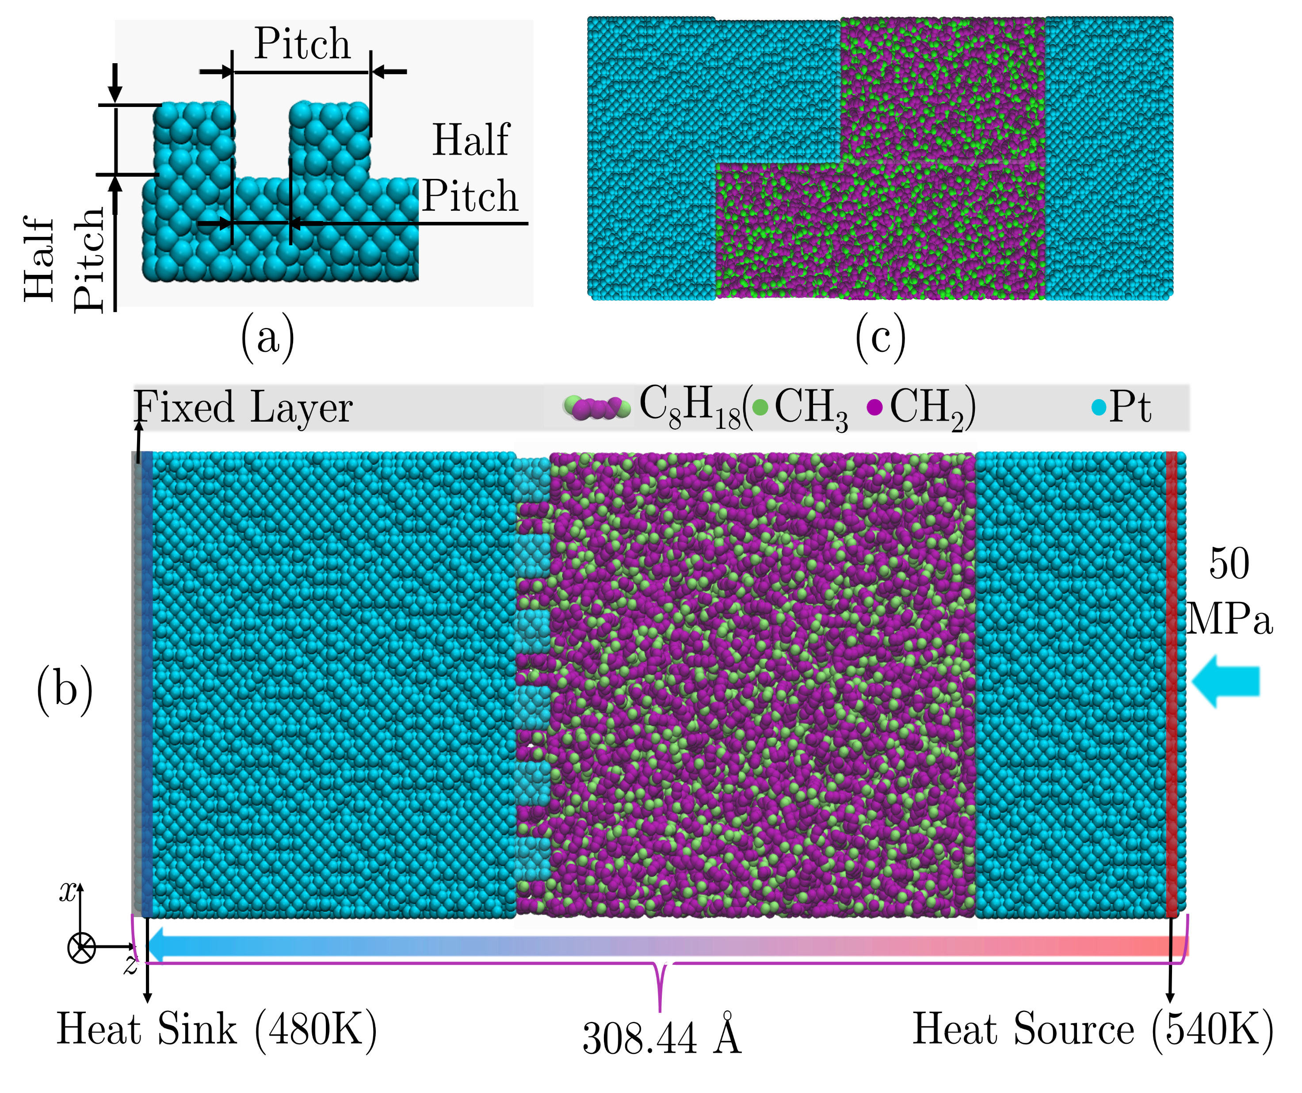
Simulation System
polymer chain-length:
8, 16, 24, 36
pitch length:
0
19.575005 Å
117.45003 Å
definition of pitch
small groove system
large groove system
All The Systems:
L_{x}=L_{y}=117.45 Å
N_{united-atom} = 43200
NEMD techniques were applied.
Notes:
Simulation system is as shown. Chain length of TIM varied from 8 to 36. We used three kinds of surfaces, flat, pitch 19.6, pitch 117.5. fig (a) is a definition of pitch, we set the depth and width of groove to be the same that the apparent area is twice of cross-section area. NEMD techniques were used. The temperature of heat sink and heat source were controlled using langevin thermostat. And to obtain steady state and linear temperature distribution

Slide 6
Potential
potential models
Platinum solid: Morse potential (Pamuk H Ö, et al. Phys. Status Solidi A 37, 1976)
n-alkane: NERD potential (Nath S K, et al. J. Chem. Phys. 108.23, 1998)
The Lorentz-Berthelot combining rule is adopted to LJ interactions between sites of different types.
NERD potential
Morse potential
Affinity
0.1: low affinity
0.5: high affinity
Notes:
For solid interaction, morse model was used. polymer used nerd potential to interact. Lorentz-Berthelot rule was adopted too. about simulation procedures, anneal system firstly then equilibrate system to obtain a steady heat flux. Finally the production run was performed. We calculate ITR every 8ns, use five ITR to evaluate the error.

Slide 7
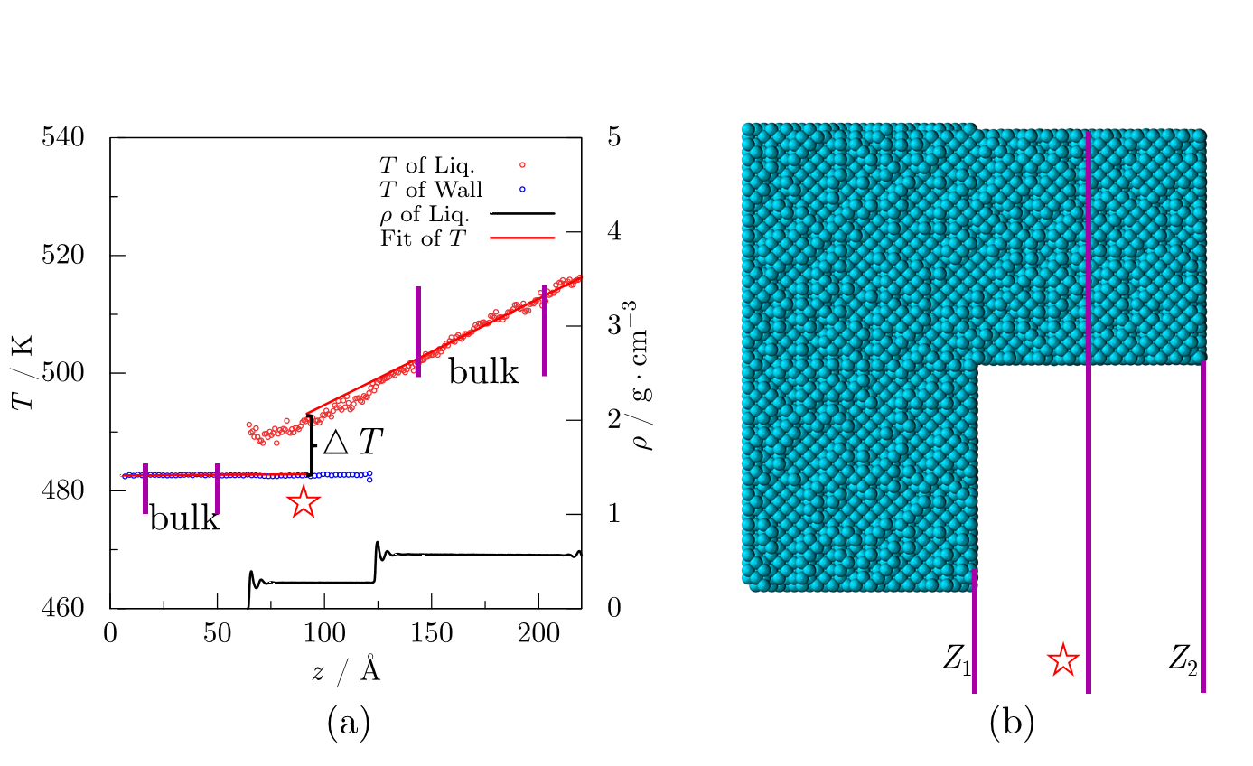
ITR Calculation
linear fitting of T
interface position
C8 large groove
low affinity
x
⊕
z
calculate ITR every 8ns, five ITR to estimate error
rough surface: midpoint of rightmost layer position of not grooved section, Z₁, and that of grooved section, Z₂
flat surface: middle position of rightmost layer and that of first density peak
Fourier’s Law:
Notes:
interface position is very import to the itr result. In this work, for rough surface systems, we choose midpoint of Z1 and Z2. Z1 is the position of rightmost layer of not grooved section. Z2 is that of grooved section. for flat systems, middle position of rightmost layer and first density peak position. Then select bulk regions to do linear fitting. And get ITR according to fourier’s law finally.

Slide 8
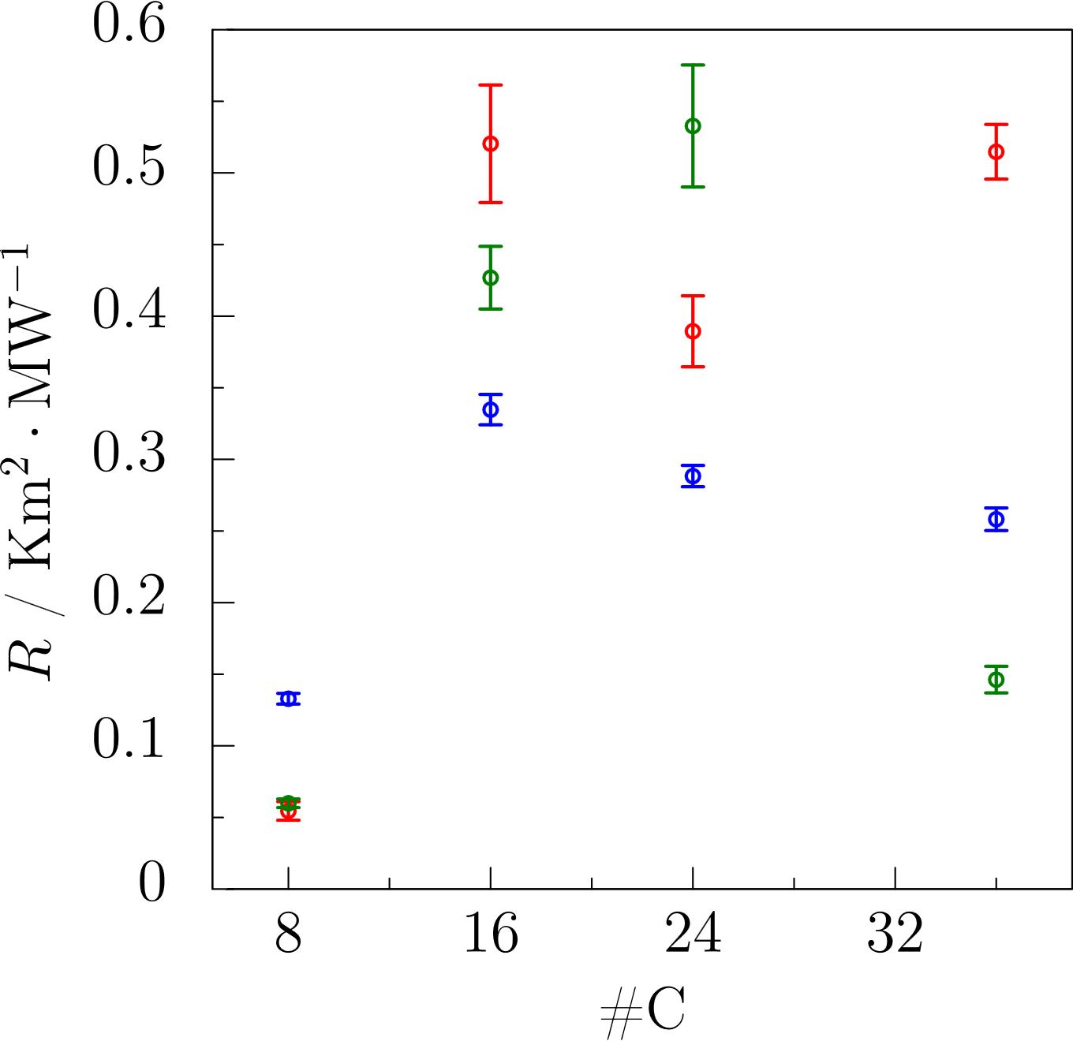
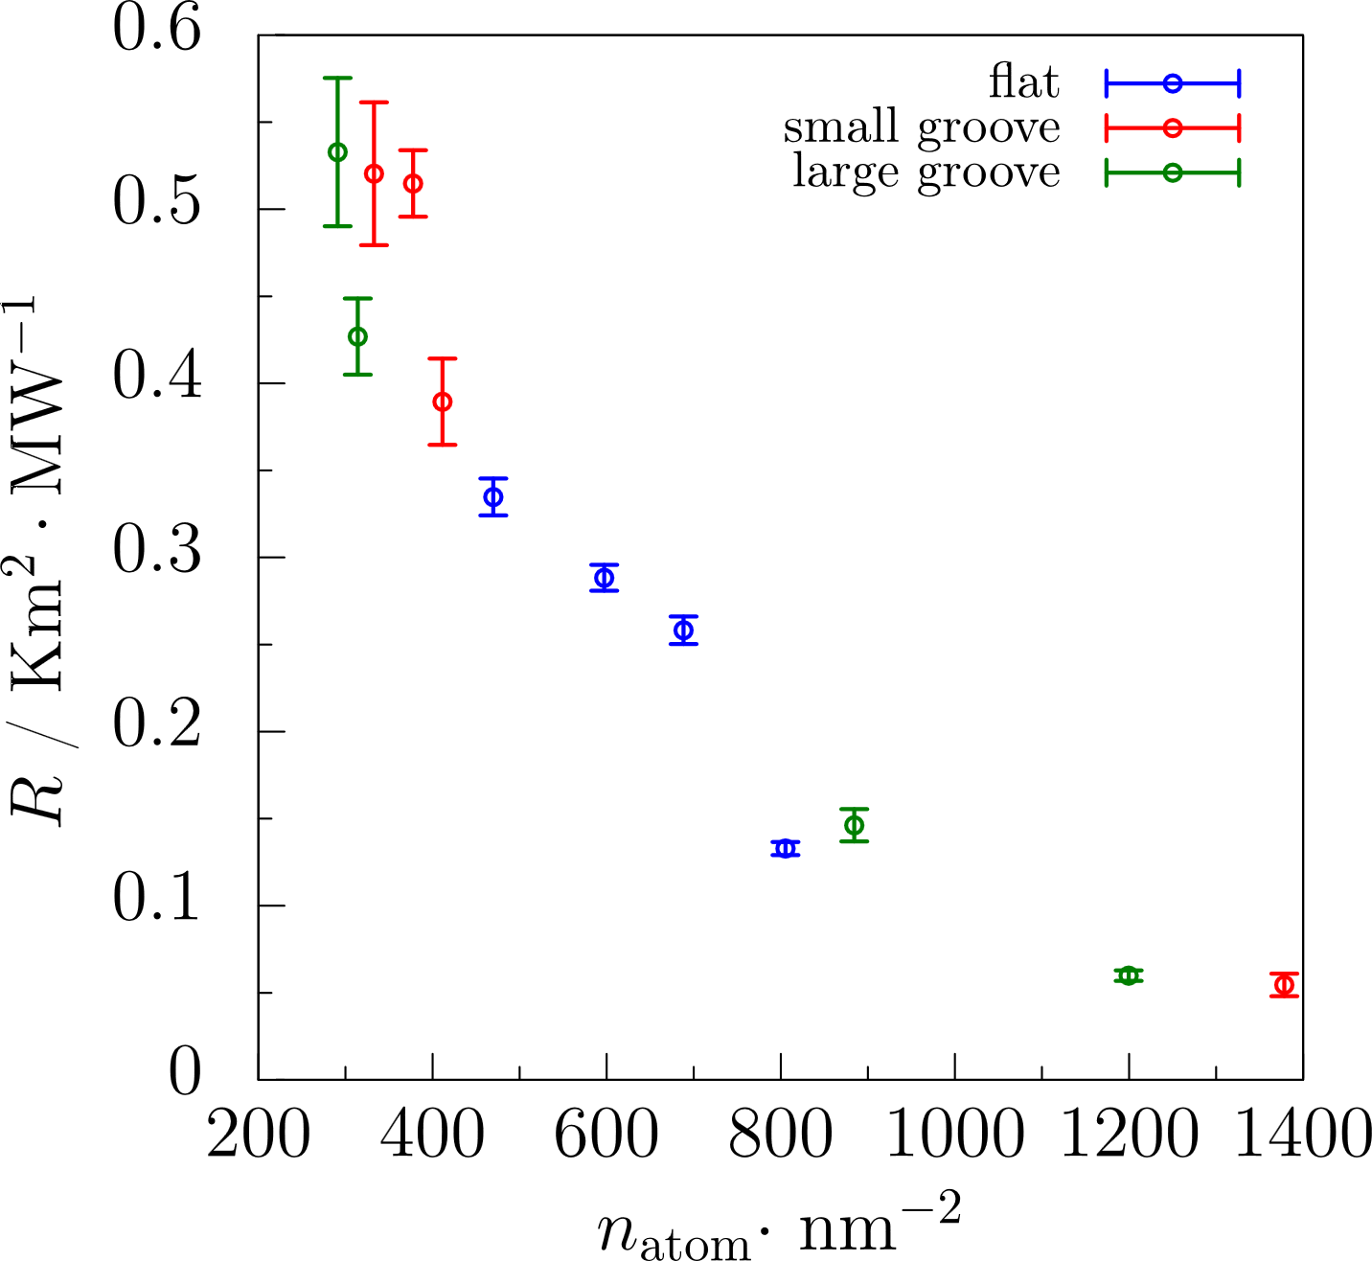
Results at low affinity
ITR at different roughness scales
adsorbed atoms per cross-section area
C8
ITR varies with chain-length
shortest chain performed best interface thermal transport ability
Roughness is not beneficial for most systems
n_{atom} ITR
Notes:
For the itr at eta of 0.1, we found itr varies with chain-length but the apparent rule is hard to be summarized. C8 performed best interface thermal transport ability. For most systems, rough surface is not beneficial to decrease ITR.
We calculated the adsorbed atom number per cross-section area. An apparent correlation that more adsorbed atoms result into smaller ITR.

Slide 9
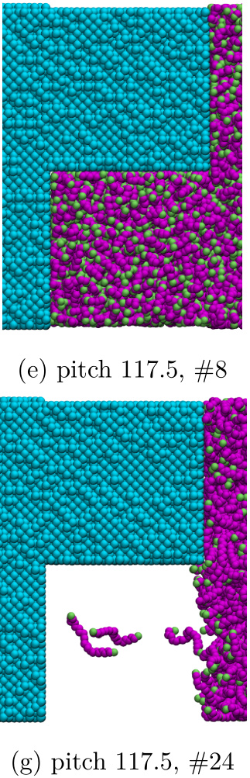
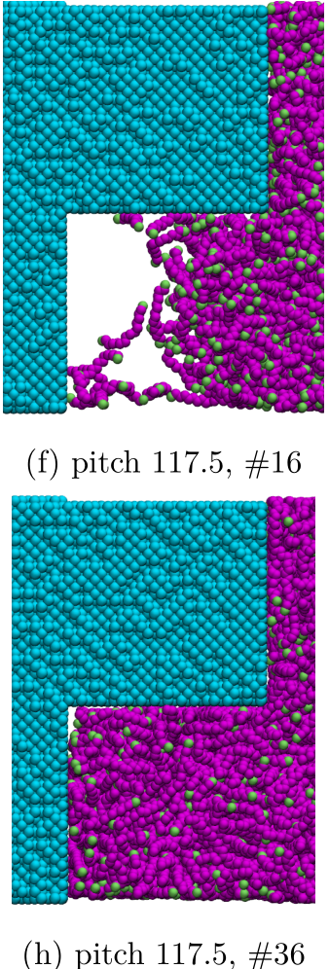
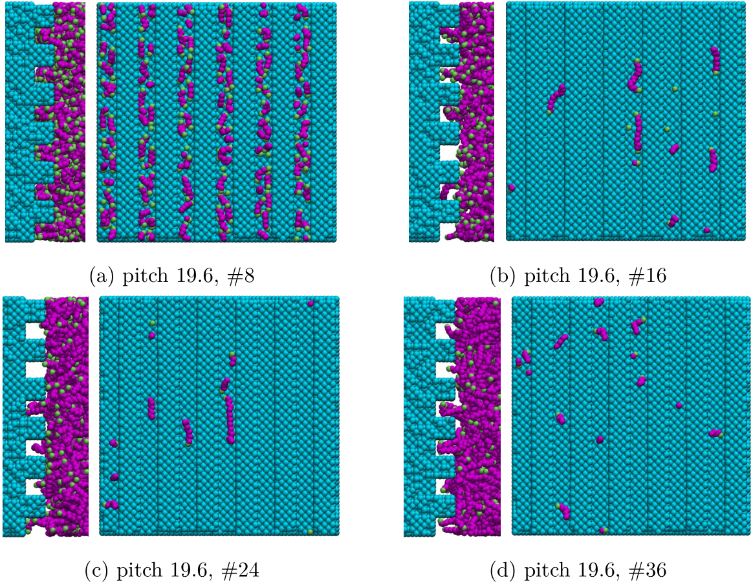
Polymer Inside Grooves at low affinity
large ITR
minimum ITR
large ITR
x
⊕
z
large ITR
large ITR
Most systems cannot make use of additional area due to grooving.
largest ITR
C8-small groove & C8-large groove & C36-large groove can make use of additional surface area.
previous Au-Ar-Au work: all grooves were at Cassie state at low affinity
Notes:
From the polymer state inside grooves, we can find most systems cannot make use of additional area due to grooving. Only C8-pitch 19.6 C8-pitch 117.5 and C36-pitch 117.5 can make use of additional surface area. This is different from our previous work for gold-argon-gold system, we found all grooves were not filled at low affinity.

Slide 10
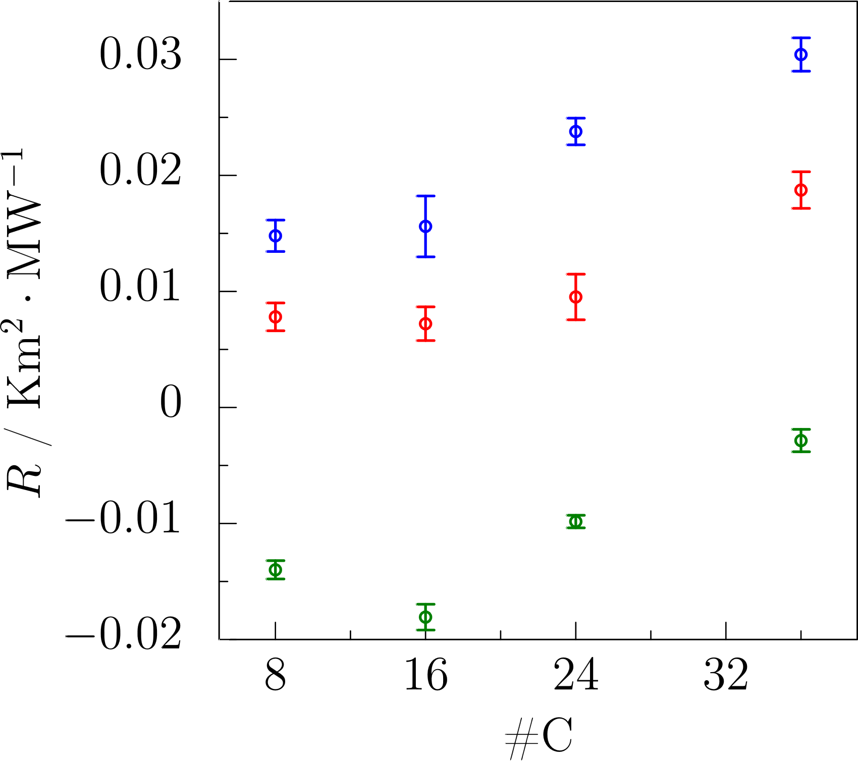
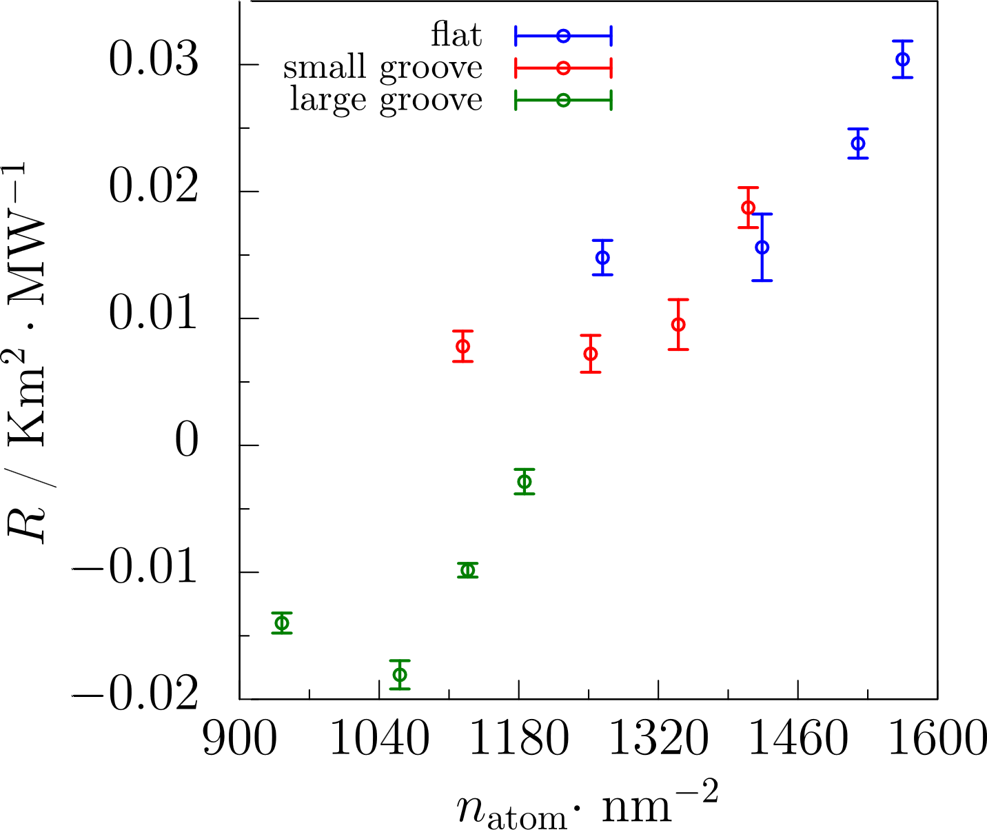
Results at high affinity
ITR at different roughness scales
adsorbed atoms per apparent area
C8
ITR increases with chain-length overall
ITR_{large groove} < ITR_{small groove} < ITR_{flat}
ITR_{C8} close to ITR_{C16}
n_{atom}
ITR
Unexpected result
Notes:
For the results at eta of 0.5, we can saw that itr increases with chain-length overall; ITR of flat surface system is larger than pitch 19.6 system. And pitch 117.5 has minimum itr. And itr of c8 is close to itr of c16. A surprising finding is that it seems more adsorbed atoms will cause larger ITR. It is contradict with traditional cognition.

Slide 11
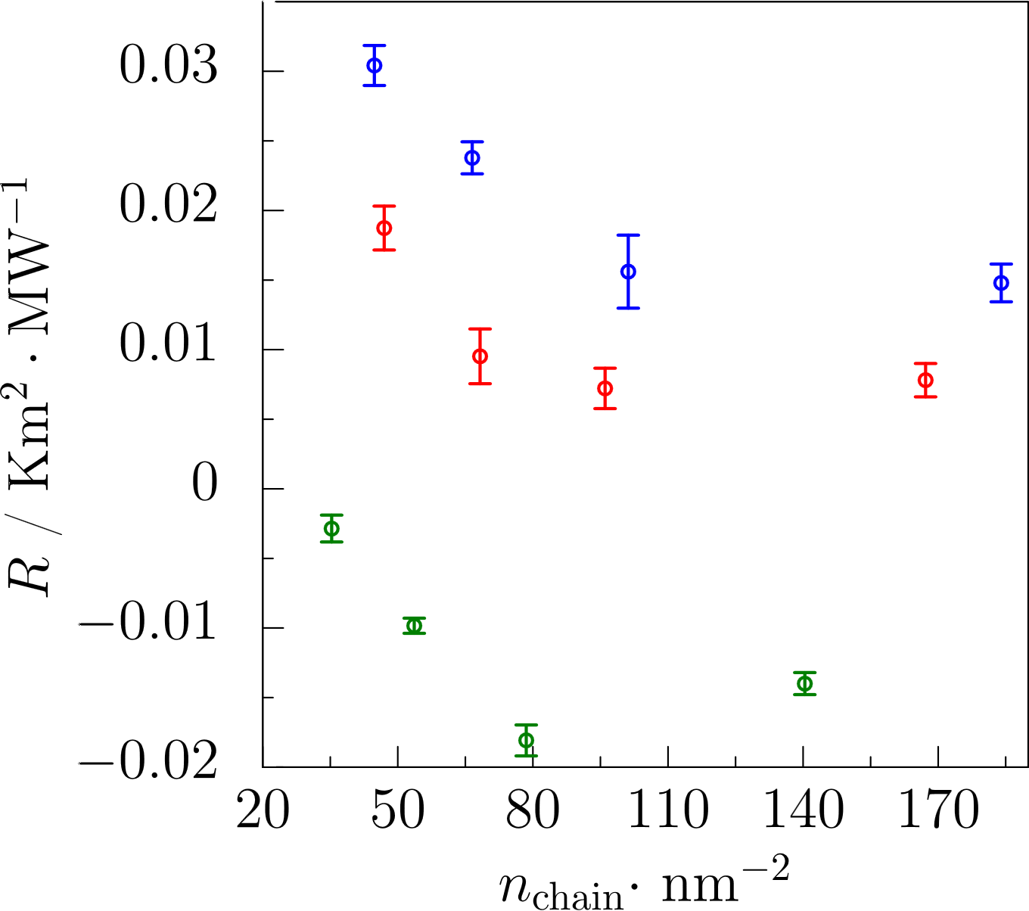
Results at η of 0.5
adsorbed chains per apparent area
n_{chain}
ITR
C16
C8
Transport term
Interaction term
Intramolecular interaction contribution dominantes as chain-length over 16.
more adsorbed chains may produce more heat paths.
Ohara T, et al. J. Chem. Phys. 135, 034507 (2011)
Matsubara H, et al. J. Chem. Phys. 142, 164509 (2015)
Notes:
We estimated the adsorbed chains per apparent area. The trend is more adsorbed chains can decrease itr. We thinks we should care adsorbed chains rather than adsorbed atoms at high eta. Our previous work found intramolecular interaction contribution dominates as chain-length over 16. Transport term is similar because thermal energy can be transported between solid and liquid easily due to their compact contact. then intramolecular term would plays an important role on the difference of interface thermal transport ability at high eta.

Slide 12
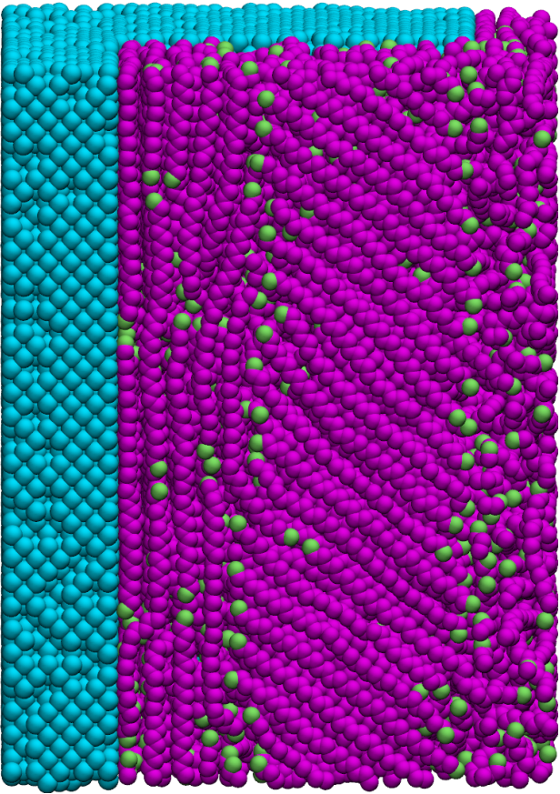
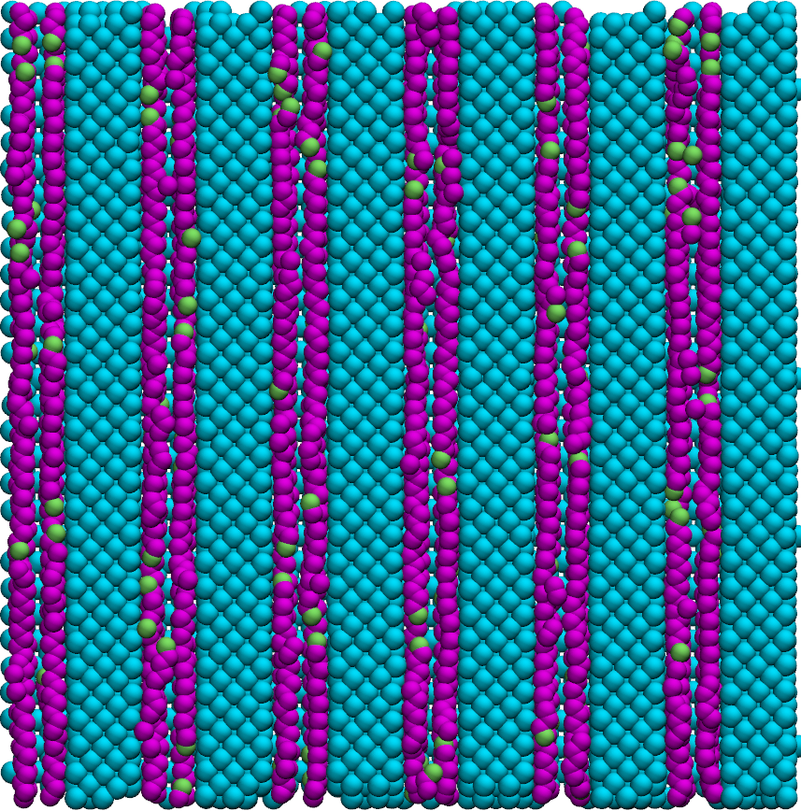
Polymer Inside Grooves at high affinity
chains is constrained vertical to heat flux
heat flux
x
y
x
z
⊕
C36, large groove
y
C36, small groove
In case of large groove, x-z interfaces can adsorb chains at direction not vertical to overall heat flux direction.
Additional area due to grooving can be made full use of .
ITR_{large groove}< ITR_{small groove}
Orientation of chains effects heat conduction.
ITR_{rough}< ITR_{flat}
Nakano T, et al. J. Chem. Phys. 133, 154705 (2010)
Notes:
By observing chains adsorbed on the surface vertical to cross-section, we can find lots of chains oriented at direction not vertical to the overall heat flux direction. pitch 117.5 can provide such surface while pitch 19.6 cannot. It cause itr of pitch 117.5 is smaller than pitch 19.6. from the density distribution of pitch 19 systems, we can find the additional area due to grooving can be made full use of. it explains why itr of rough systems is smaller than flat systems

Slide 13
Conclusion
ITR is effected by the chain-length of polymer TIM: at low affinity, the rule of correlation is hard to summarize; at high affinity, ITR increases with chain-length overall.
Shortest chain length performed best interface thermal transfer ability at all roughness scales.
At low affinity: roughness is not beneficial as the additional area cannot be made full use of. In general, more adsorbed atoms result into smaller ITR.
At high affinity: ITR increases with chain-length overall. Adsorbed chains rather than atoms should be cared. More adsorbed chains can cause smaller ITR which may produce more heat paths. Large groove systems own surfaces adsorbing chains orienting at directions not vertical to overall heat flux. ITR_{large groove}< ITR_{small groove} < ITR_{flat}.
This work was supported by JST CREST Grant Number JPMJCR17I2
Notes:
In this work, blah blah…

Slide 15
Existing Research on ITR of SLS System
work of our group
Au-Ar-Au system
Surblys D, et al. J. Chem. Phys. 150, 114705 (2019)
at low η: ITR_{large pitch} > ITR_{small pitch}
at high η: ITR_{rough surface} < ITR_{flat surface}
at η close to 1: highly ordered liquids increase ITR
Polyatomic SLS system should be paid more attention. Roughness is an essential parameter on ITR.
work of others
Ag-Ar-Ag system
Same fractal dimension and depth of roughness have same ITR and liquid density profiles.
Increase roughness won’t be helpful to decrease ITR at high η.
Frank M, et al. J. Chem. Phys. 151, 134705 (2019)

Slide 16
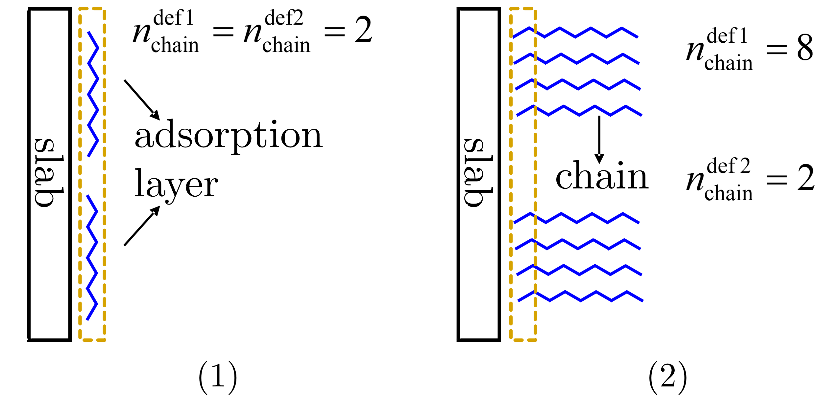

Slide 17
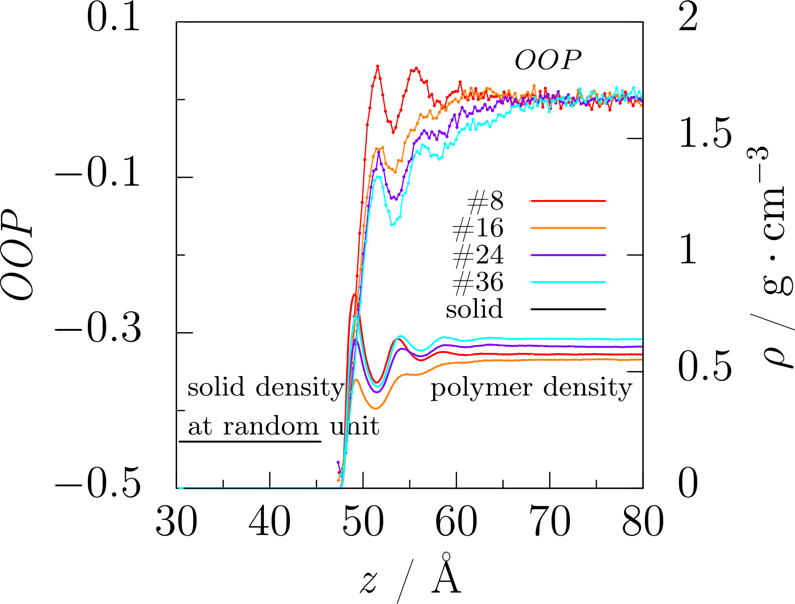
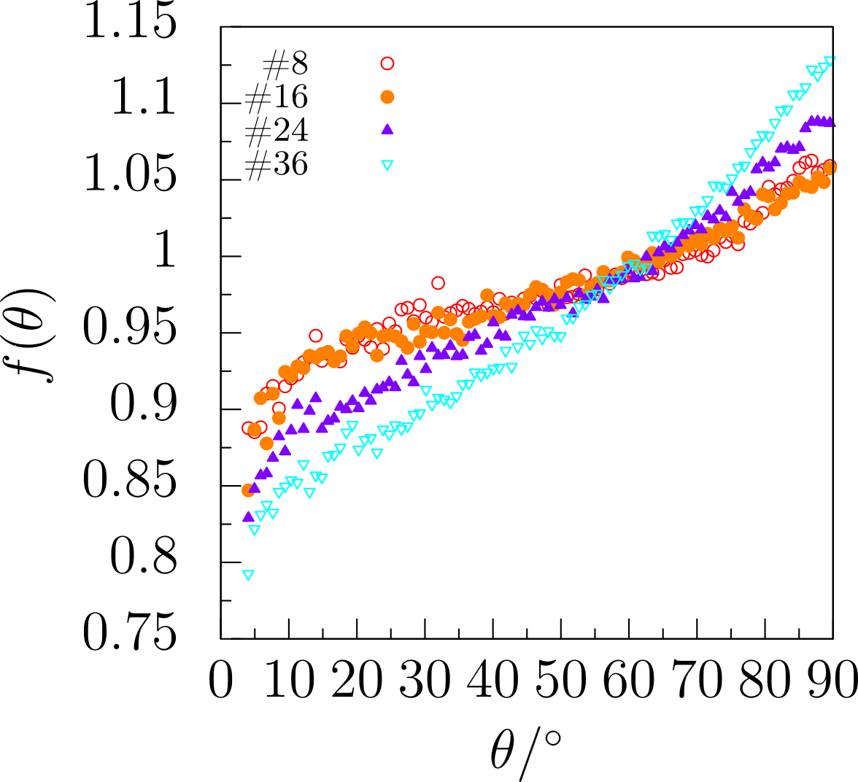
Liquid Structure at η of 0.1
orientation order parameter
orientation angle probability
for flat surface systems
No apparent correlation between OOP and ITR was found.
OOP = 1: vertical to cross-section
OOP = -0.5: parallel to cross-section
Notes:
We estimated orientation order parameter of polymer near the interface. oop equals to 1 means chains in the slab has the orientation vertical to cross section, -0.5 means the orientation paralleling to cross-section. As oop cannot represent chain’s orientation distribution clearly, we only present flat surface systems. We also calculated the orientation angle probability density. We found the trend of each system was similar. So we think there is no apparent correlation between OOP and ITR.

Slide 18
Background
TIM categories
Type | Account
phase change TIMs | 4%
metallic TIMs | 9%
polymer-based TIMs | 87%
data source: BCC research
highly conductive
polymer
merits of polymer-based TIM
mechanical properties
electronic properties
chemical properties
design flexibility
low price
conformability
polymer matrix + filler
nanocomposites; nanowires
ceramic, metal,
carbon nanotube,
graphene, et.al
Notes:
We can classify TIM into phase change TIMs, metallic TIMs and polymer based TIMs. The last one occupied most of market. polymer based TIM can further divided into two types: purely polymer with high intrinsic thermal conductivity. And composites of polymer matrix and filler. It owns lots of merits including good mechanical electronic chemical properties. Design flexibility. At low price. And the conformability.

Slide 19
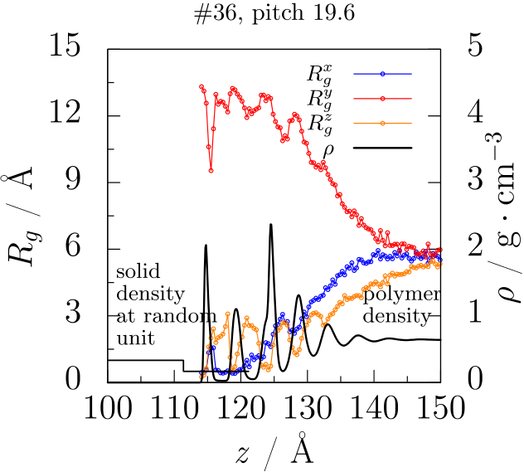
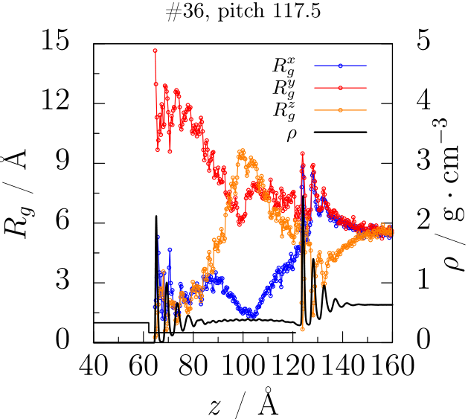
Rog to explain pitch size setting
Notes:
We can classify TIM into phase change TIMs, metallic TIMs and polymer based TIMs. The last one occupied most of market. polymer based TIM can further divided into two types: purely polymer with high intrinsic thermal conductivity. And composites of polymer matrix and filler. It owns lots of merits including good mechanical electronic chemical properties. Design flexibility. At low price. And the conformability.

Slide 20
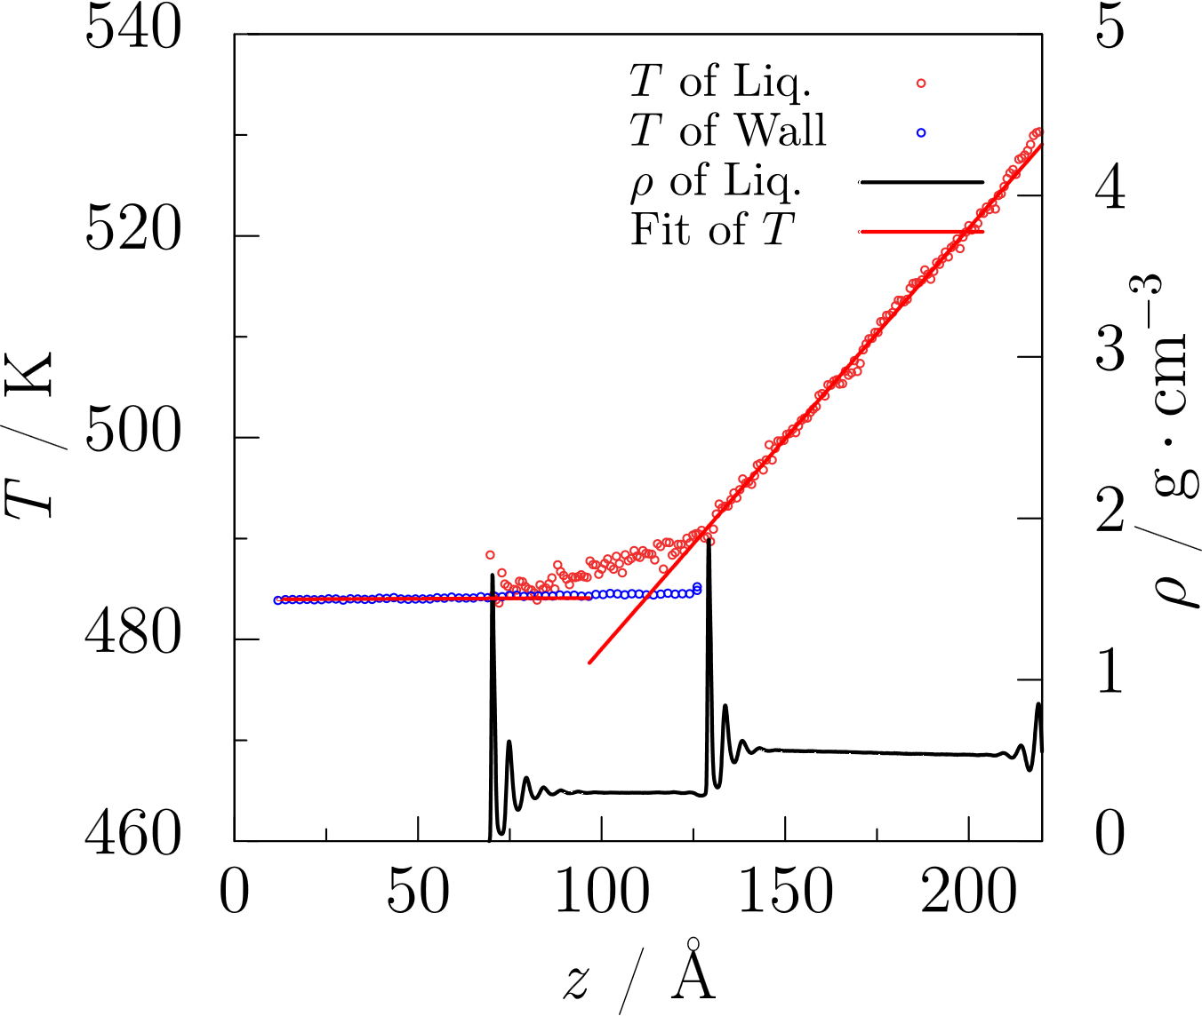
Negative ITR
linear fitting of T
C16
large groove high affinity
negative temperature jump
Notes:
interface position is very import to the itr result. In this work, for rough surface systems, we choose midpoint of Z1 and Z2. Z1 is the position of rightmost layer of not grooved section. Z2 is that of grooved section. for flat systems, middle position of rightmost layer and first density peak position. Then select bulk regions to do linear fitting. And get ITR according to fourier’s law finally.

Slide 21
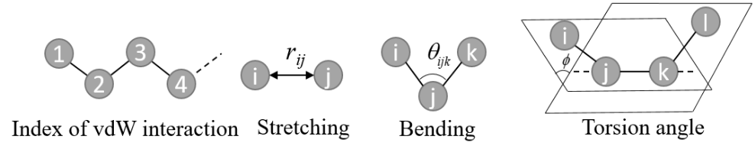
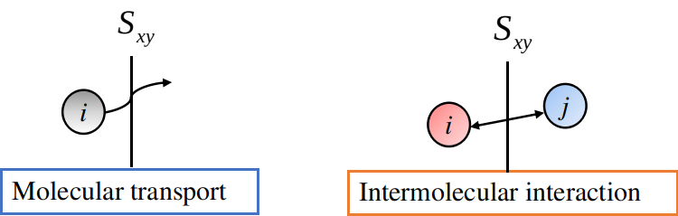
Intramolecular interaction

Slide 22
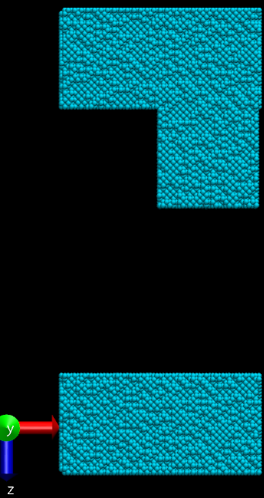
Cross-plane, apparent area explanation
cross- section: x-y plan
S_{cross-section}=l_{x}*l_{y}
l_{x} = 2* l_{x1}
S_{apparent}=2*(l_{x1}+ l_{z1}) *l_{y}
l_{x1}
l_{z1}
Notes:
interface position is very import to the itr result. In this work, for rough surface systems, we choose midpoint of Z1 and Z2. Z1 is the position of rightmost layer of not grooved section. Z2 is that of grooved section. for flat systems, middle position of rightmost layer and first density peak position. Then select bulk regions to do linear fitting. And get ITR according to fourier’s law finally.

Slide 23
